Slide 1
BMC Cyber and Cloud Summer Courses Deep Learning for Computer Vision Overview of Deep Learning
Samuel Adebayo
sadebayo@belfastmet.ac.uk

Slide 2
Agenda
Overview of Deep Learning: Key Concepts and History
How Deep Learning has Revolutionised Computer Vision
Introduction to Neural Networks:
Layers,
Neurons,
Activation Functions

Slide 3
Overview of Deep Learning
A subset of Machine Learning focused on Neural Networks with many layers (deep neural networks) that can learn hierarchical representations of data.
Key Characteristics:
Learning from large amounts of data
Multi-layered neural networks
Ability to model complex patterns

Slide 4
Historical Context of Deep Learning
1960s – 1980s: Early Neural Network models (perceptron, Backpropagation).
1990s – Decline in interest due to limited computational power and data.
2006: Resurgence with Geoffery Hinton’s work on deep belief networks.
2012: Breakthrough in Image Recognition (AlexNet, ImageNet competition)

Slide 5
Key Concepts in Deep Learning
Neural Networks: The fundamental building blocks, consisting of layers of interconnected neurons.
Backpropagation: The method for training neural networks by adjusting weights based on the error.
Gradient Descent: An optimisation technique to minimise the error in neural networks.
Overfitting: When a model learns the noise in the training data instead of the actual pattern.

Slide 6
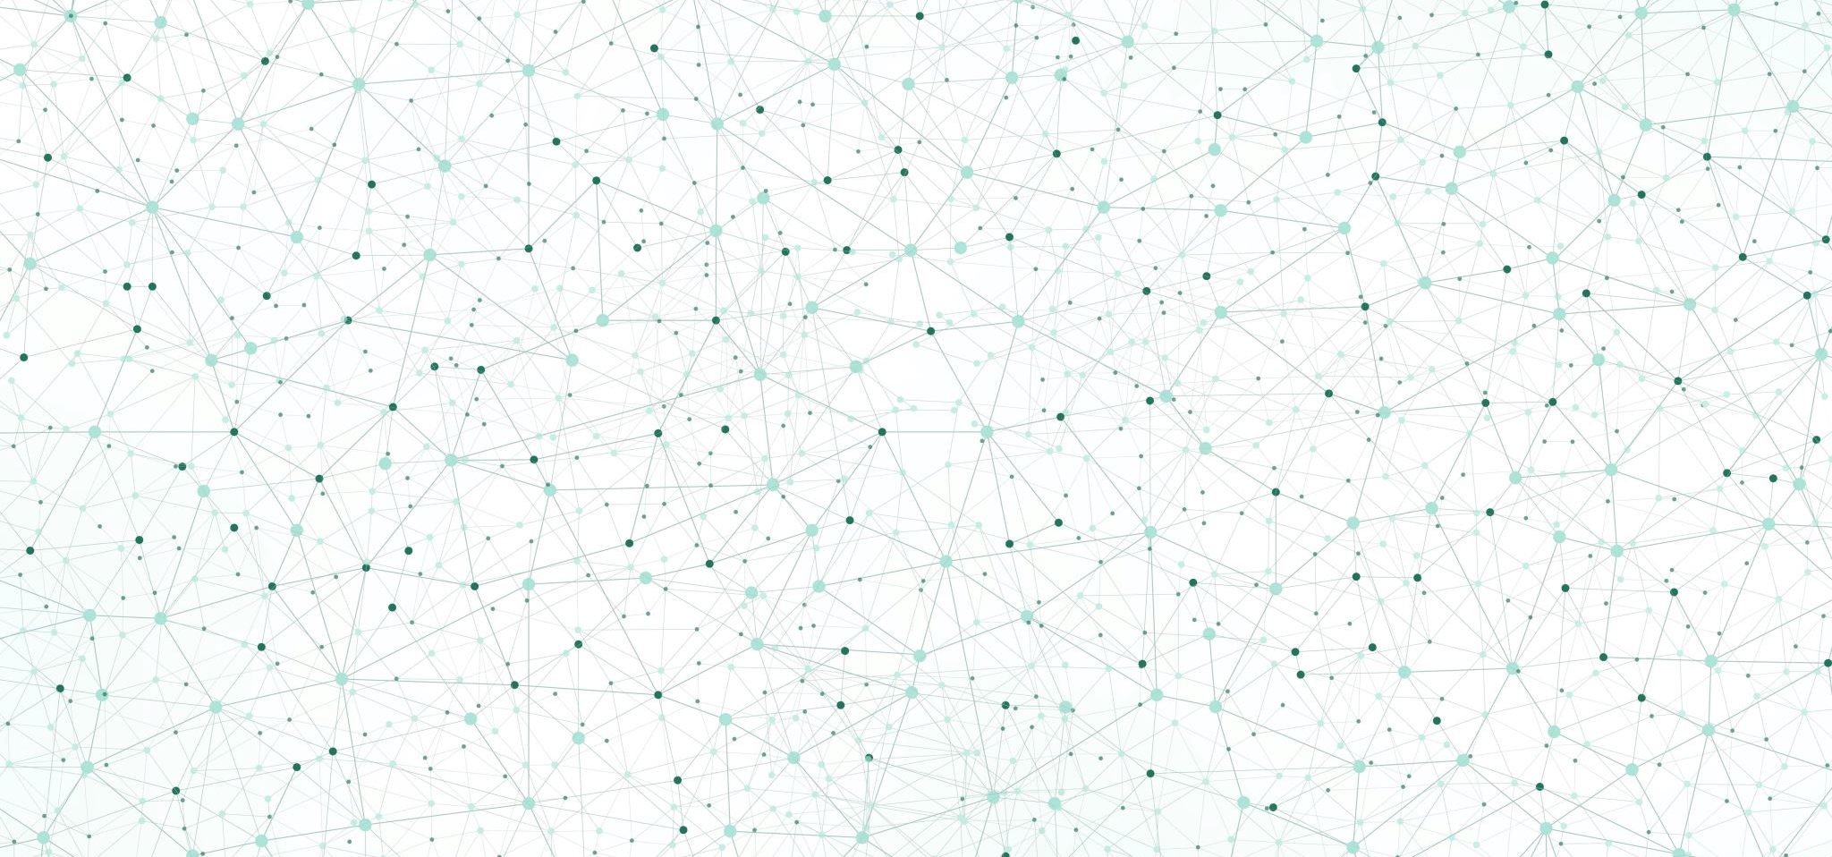
How Deep Learning has Revolutionised Computer Vision

Slide 7
The State of Computer Vision Before Deep Learning
Traditional Methods: Feature extraction using SIFT, HOG, and manual feature engineering.
Challenges: Limited by the quality of features, time-consuming, less adaptable to new tasks.

Slide 8
Deep Learning in Computer Vision
Convolutional Neural Networks (CNNs): Revolutionised the field by automatically learning spatial hierarchies of features.
Impact on Tasks:
Image Classification: Automatic identification of objects in images (e.g. ImageNet)
Object Detection: Locating and classifying multiple objects in images (e.g. YOLO, Faster R-CNN)
Segmentation: pixel-level classification of images (e.g. U-Net, Mask R-CNN)
Generative models: Creating new images from scratch (e.g. GANs)

Slide 9
Real-world Applications of Deep Learning in Computer Vision
Healthcare: Automated diagnosis from medical images (e.g., detecting tumours in X-rays).
Autonomous Vehicles: Object detection and scene understanding for navigation.
Security: Facial recognition and surveillance systems.
Art & Creativity: Style transfer, image synthesis, and more.

Slide 10

Introduction to Neural Networks

Slide 11
The Basics of Neural Networks
Neurons: The basic units of a neural network, analogous to the biological neurons in the brain.
Layers:
Input Layer: Receives the input data.
Hidden Layers: Intermediate layers where feature transformation occurs.
Output Layer: Produces the final prediction or output.

Slide 12
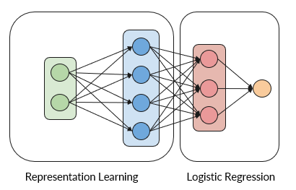
A Neural Network
The first part of our network represents the input in higher dimensional space, we call this representation learning or feature extraction.
In the last layer of our network we apply, logistic regression to obtain the probabilities of true results.

Slide 13
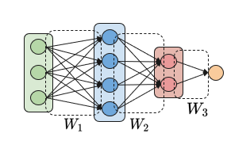
How to Design a Neural Network
We refer to the design of the network as the network architecture:
You need to decide on:
The number of hidden layers
The number of neurons per layer (referred to as width)
The activation function for each neuron
Other hyperparameters and parameters (tbdl)

Slide 14



Activation Functions
Purpose: Introduce non-linearity to the model, enabling it to learn complex patterns.
Common Activation functions
Sigmoid
ReLU (Rectified Linear Unit)
Tanh

Slide 15
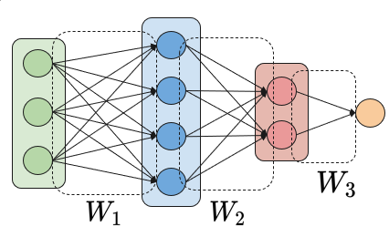
So, wh what does Learning Mean
Learning in a neural network means finding ‘good’ weights of the connections between the various neurons.
We can learn these weights from the likeness of our training data.

Slide 16
Forward and Backward Propagation
Forward Propagation: The process by which inputs are passed through the network to generate an output.
Backward Propagation: The process of updating weights based on the error gradient to minimise the loss function.

Slide 17

Questions?

Slide 18

Thank You
See you soon

